Slide 1
Binary Search

Slide 2
Binary Search
In computer science, binary search is a search algorithm that finds the position of a target value within a sorted array.
Examples:
Seeking word in dictionary

Slide 3
Binary Search
Binary search compares the target value to the middle element of the array:
If the target value matches the element, its position in the array is returned.
If the target value is less than the element, the search continues in the lower half of the array.
If the target value is greater than the element, the search continues in the upper half of the array.
If the search ends with the remaining half being empty, the target is not in the array.
By doing this, the algorithm eliminates the half in which the target value cannot lie in each iteration.

Slide 4
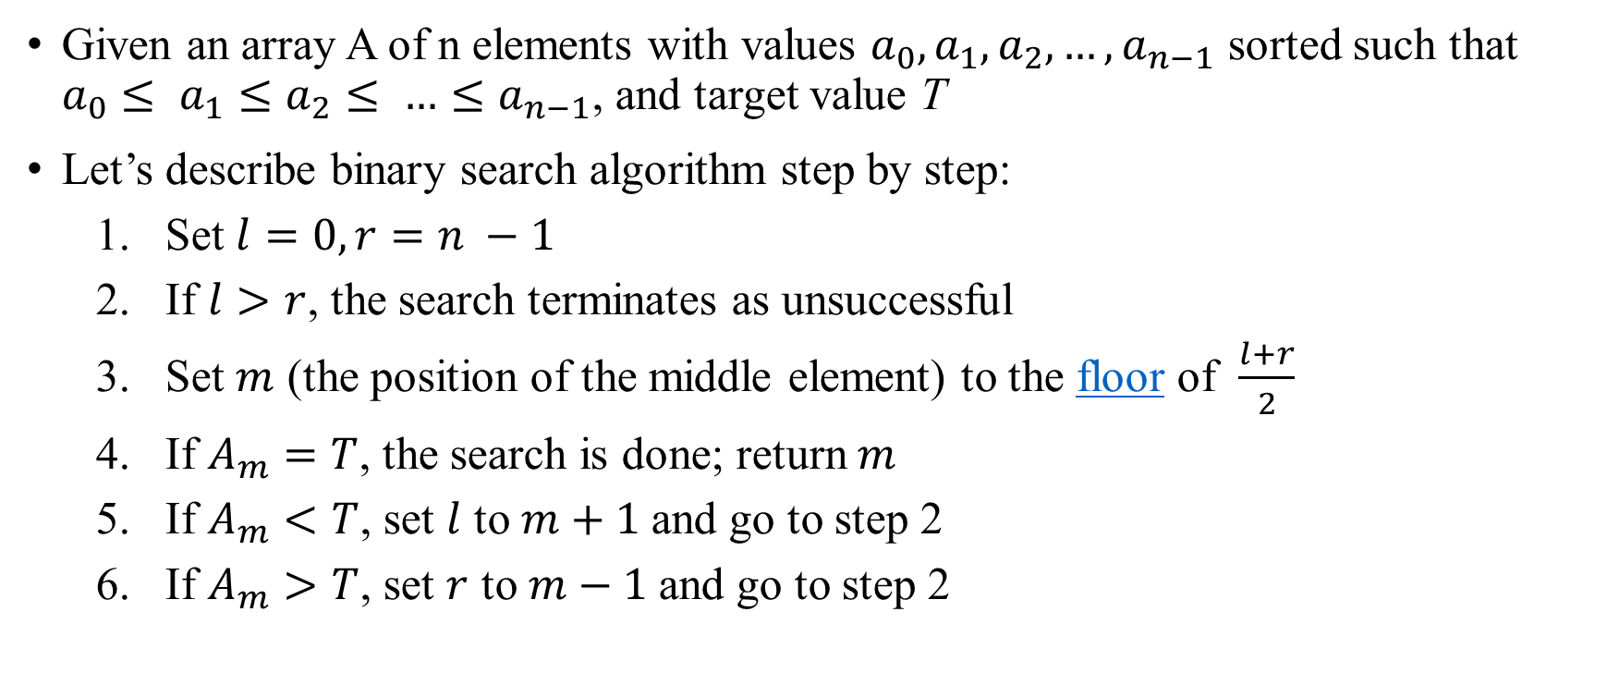
Binary Search Algorithm
Given an array A of n elements with values $a_{0}, a_{1}, a_{2}, …,a_{n−1}$ sorted such that $a_{0}≤ a_{1}≤a_{2}≤ …≤a_{n−1}$, and target value T
Let’s describe binary search algorithm step by step:
Set $l=0, r=n −1$
If $l>r$, the search terminates as unsuccessful
Set $m$ (the position of the middle element) to the floor of $\frac{l+r}{2}$
If $A_{m}=T$, the search is done; return $m$
If $A_{m}<T$, set $l$ to $m+1$and go to step 2
If $A_{m}>T$, set $r$ to $m−1$and go to step 2

Slide 5
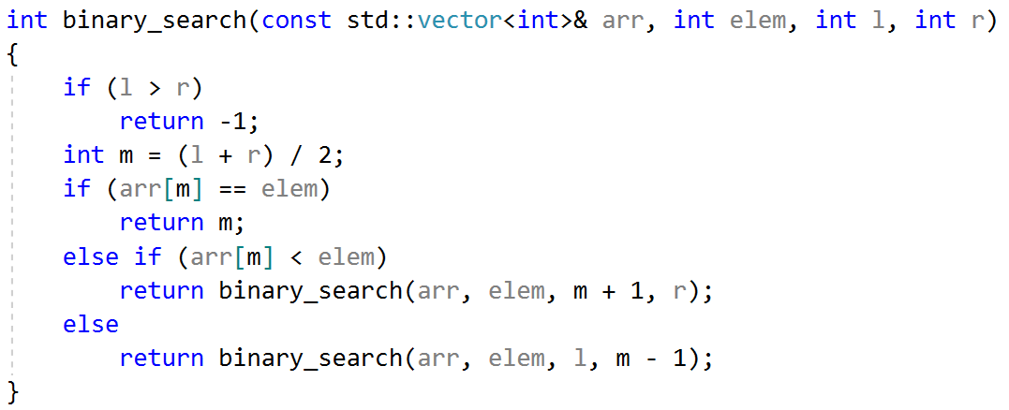
Binary Search Calculations: recursive method

Slide 6
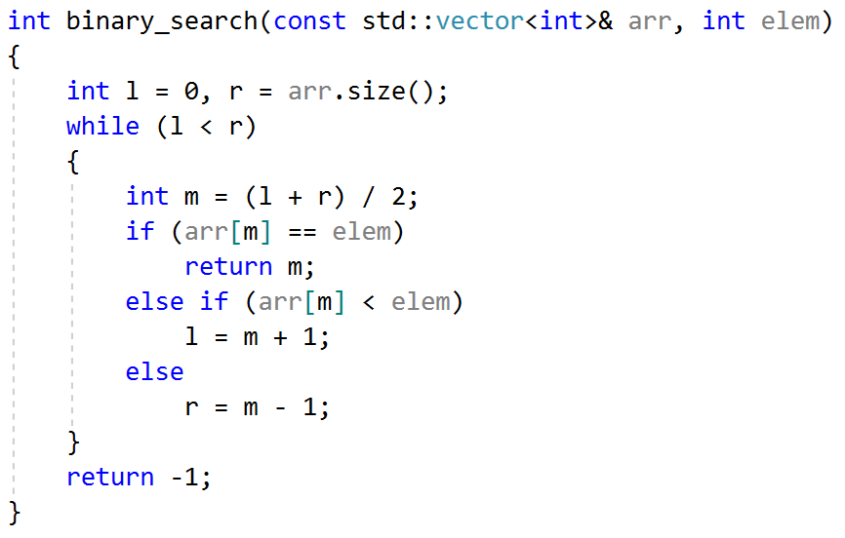
Binary Search Calculations: iterative method

Slide 7
Binary Search Example
Need to find number 30 in the array:
Index | 0 | 1 | 2 | 3 | 4 | 5 | 6 | 7 | 8 | 9 | 10 | 11 | 12 | 13 | 14 | 15
Array | 1 | 3 | 4 | 6 | 7 | 9 | 12 | 14 | 15 | 18 | 26 | 28 | 30 | 32 | 33 | 38

Slide 8
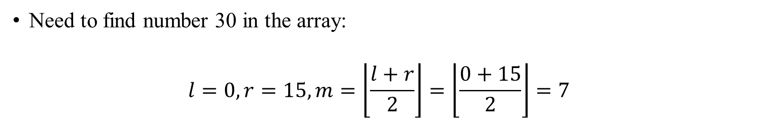
Binary Search Example
Need to find number 30 in the array:
$$l=0, r=15, m=\left\lfloor \frac{l+r}{2}\right\rfloor =\left\lfloor \frac{0+15}{2}\right\rfloor =7$$
Index | 0 | 1 | 2 | 3 | 4 | 5 | 6 | 7 | 8 | 9 | 10 | 11 | 12 | 13 | 14 | 15
Array | 1 | 3 | 4 | 6 | 7 | 9 | 12 | 14 | 15 | 18 | 26 | 28 | 30 | 32 | 33 | 38

Slide 9
Binary Search Example
Need to find number 30 in the array:
$$l=0, r=15, m=\left\lfloor \frac{l+r}{2}\right\rfloor =\left\lfloor \frac{0+15}{2}\right\rfloor =7$$
Index | 0 | 1 | 2 | 3 | 4 | 5 | 6 | 7 | 8 | 9 | 10 | 11 | 12 | 13 | 14 | 15
Array | 1 | 3 | 4 | 6 | 7 | 9 | 12 | 14 | 15 | 18 | 26 | 28 | 30 | 32 | 33 | 38

Slide 10
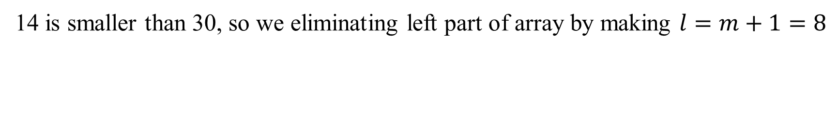
Binary Search Example
Need to find number 30 in the array:
$$l=0, r=15, m=\left\lfloor \frac{l+r}{2}\right\rfloor =\left\lfloor \frac{0+15}{2}\right\rfloor =7$$
Index | 0 | 1 | 2 | 3 | 4 | 5 | 6 | 7 | 8 | 9 | 10 | 11 | 12 | 13 | 14 | 15
Array | 1 | 3 | 4 | 6 | 7 | 9 | 12 | 14 | 15 | 18 | 26 | 28 | 30 | 32 | 33 | 38
14 is smaller than 30, so we eliminating left part of array by making $l=m+1=8$

Slide 11
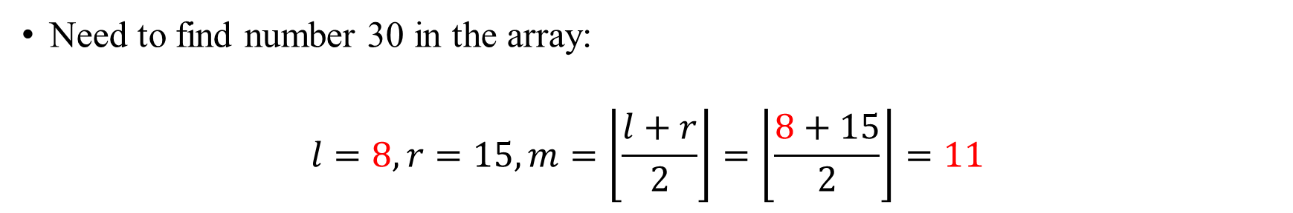
Binary Search Example
Need to find number 30 in the array:
$$l=8, r=15, m=\left\lfloor \frac{l+r}{2}\right\rfloor =\left\lfloor \frac{8+15}{2}\right\rfloor =11$$
Index | 0 | 1 | 2 | 3 | 4 | 5 | 6 | 7 | 8 | 9 | 10 | 11 | 12 | 13 | 14 | 15
Array | 1 | 3 | 4 | 6 | 7 | 9 | 12 | 14 | 15 | 18 | 26 | 28 | 30 | 32 | 33 | 38
14 is smaller than 30, so we eliminating left part of array by making $l=m+1=8$

Slide 12
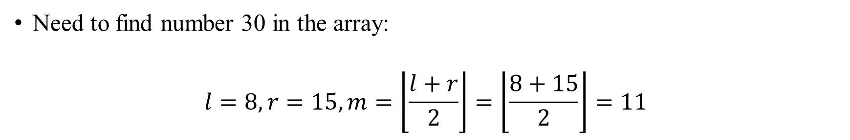
Binary Search Example
Need to find number 30 in the array:
$$l=8, r=15, m=\left\lfloor \frac{l+r}{2}\right\rfloor =\left\lfloor \frac{8+15}{2}\right\rfloor =11$$
Index | 0 | 1 | 2 | 3 | 4 | 5 | 6 | 7 | 8 | 9 | 10 | 11 | 12 | 13 | 14 | 15
Array | 1 | 3 | 4 | 6 | 7 | 9 | 12 | 14 | 15 | 18 | 26 | 28 | 30 | 32 | 33 | 38

Slide 13
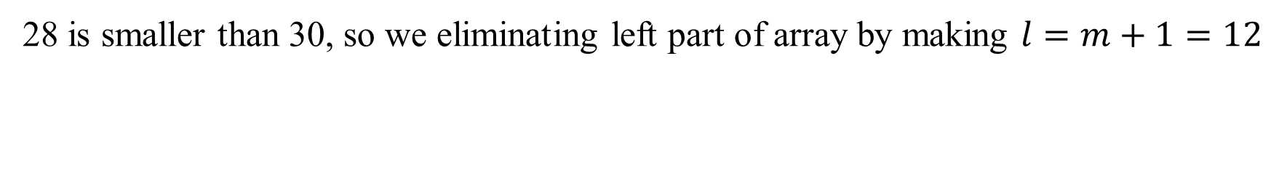
Binary Search Example
Need to find number 30 in the array:
$$l=8, r=15, m=\left\lfloor \frac{l+r}{2}\right\rfloor =\left\lfloor \frac{8+15}{2}\right\rfloor =11$$
Index | 0 | 1 | 2 | 3 | 4 | 5 | 6 | 7 | 8 | 9 | 10 | 11 | 12 | 13 | 14 | 15
Array | 1 | 3 | 4 | 6 | 7 | 9 | 12 | 14 | 15 | 18 | 26 | 28 | 30 | 32 | 33 | 38
28 is smaller than 30, so we eliminating left part of array by making $l=m+1=12$

Slide 14
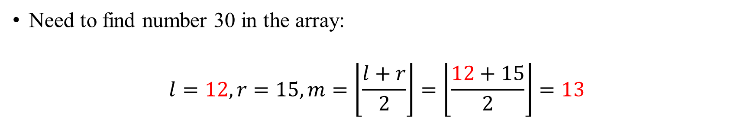
Binary Search Example
Need to find number 30 in the array:
$$l=12, r=15, m=\left\lfloor \frac{l+r}{2}\right\rfloor =\left\lfloor \frac{12+15}{2}\right\rfloor =13$$
Index | 0 | 1 | 2 | 3 | 4 | 5 | 6 | 7 | 8 | 9 | 10 | 11 | 12 | 13 | 14 | 15
Array | 1 | 3 | 4 | 6 | 7 | 9 | 12 | 14 | 15 | 18 | 26 | 28 | 30 | 32 | 33 | 38
28 is smaller than 30, so we eliminating left part of array by making $l=m+1=12$

Slide 15
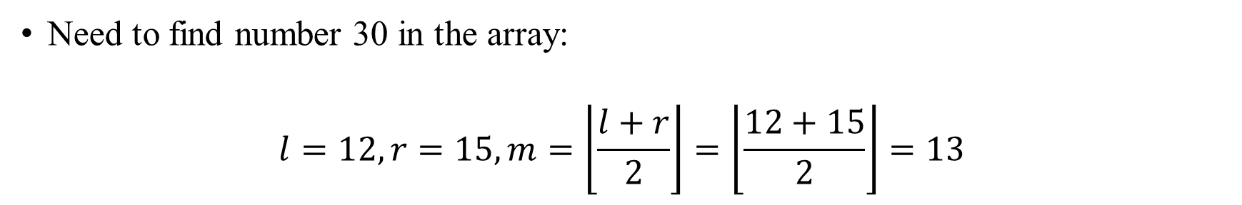
Binary Search Example
Need to find number 30 in the array:
$$l=12, r=15, m=\left\lfloor \frac{l+r}{2}\right\rfloor =\left\lfloor \frac{12+15}{2}\right\rfloor =13$$
Index | 0 | 1 | 2 | 3 | 4 | 5 | 6 | 7 | 8 | 9 | 10 | 11 | 12 | 13 | 14 | 15
Array | 1 | 3 | 4 | 6 | 7 | 9 | 12 | 14 | 15 | 18 | 26 | 28 | 30 | 32 | 33 | 38

Slide 16
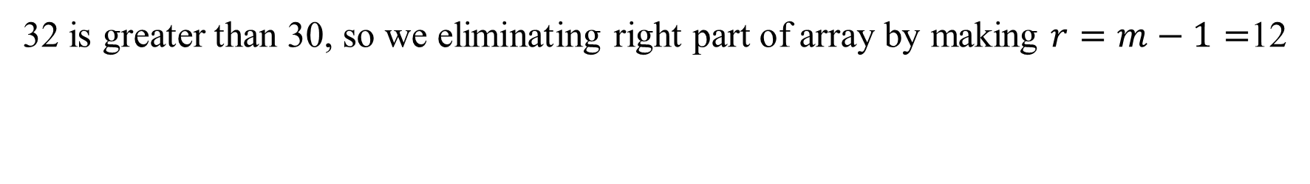
Binary Search Example
Need to find number 30 in the array:
$$l=12, r=15, m=\left\lfloor \frac{l+r}{2}\right\rfloor =\left\lfloor \frac{12+15}{2}\right\rfloor =13$$
Index | 0 | 1 | 2 | 3 | 4 | 5 | 6 | 7 | 8 | 9 | 10 | 11 | 12 | 13 | 14 | 15
Array | 1 | 3 | 4 | 6 | 7 | 9 | 12 | 14 | 15 | 18 | 26 | 28 | 30 | 32 | 33 | 38
32 is greater than 30, so we eliminating right part of array by making $r=m−1=$12

Slide 17
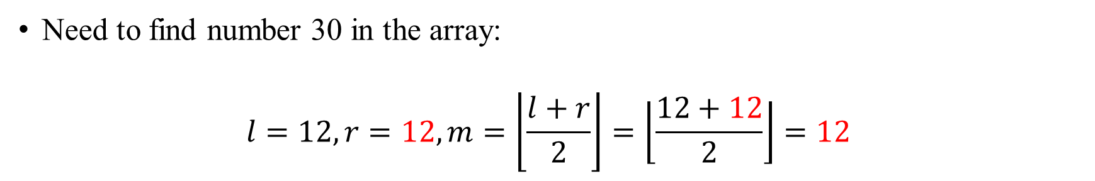
Binary Search Example
Need to find number 30 in the array:
$$l=12, r=12, m=\left\lfloor \frac{l+r}{2}\right\rfloor =\left\lfloor \frac{12+12}{2}\right\rfloor =12$$
Index | 0 | 1 | 2 | 3 | 4 | 5 | 6 | 7 | 8 | 9 | 10 | 11 | 12 | 13 | 14 | 15
Array | 1 | 3 | 4 | 6 | 7 | 9 | 12 | 14 | 15 | 18 | 26 | 28 | 30 | 32 | 33 | 38
32 is greater than 30, so we eliminating right part of array by making $r=m−1=$12

Slide 18
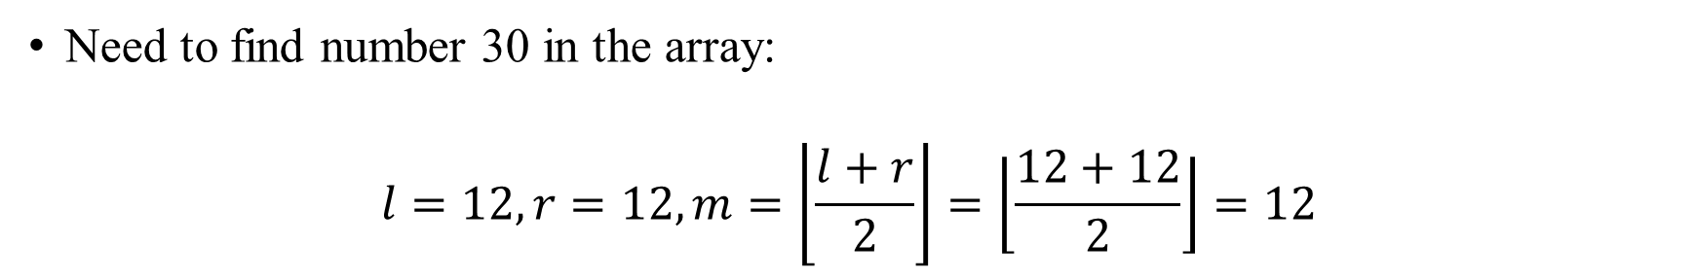
Binary Search Example
Need to find number 30 in the array:
$$l=12, r=12, m=\left\lfloor \frac{l+r}{2}\right\rfloor =\left\lfloor \frac{12+12}{2}\right\rfloor =12$$
Index | 0 | 1 | 2 | 3 | 4 | 5 | 6 | 7 | 8 | 9 | 10 | 11 | 12 | 13 | 14 | 15
Array | 1 | 3 | 4 | 6 | 7 | 9 | 12 | 14 | 15 | 18 | 26 | 28 | 30 | 32 | 33 | 38

Slide 19
Binary Search Example
Need to find number 30 in the array:
$$l=12, r=12, m=\left\lfloor \frac{l+r}{2}\right\rfloor =\left\lfloor \frac{12+12}{2}\right\rfloor =12$$
Index | 0 | 1 | 2 | 3 | 4 | 5 | 6 | 7 | 8 | 9 | 10 | 11 | 12 | 13 | 14 | 15
Array | 1 | 3 | 4 | 6 | 7 | 9 | 12 | 14 | 15 | 18 | 26 | 28 | 30 | 32 | 33 | 38
30 is equal to 30, so we found needed index which is 12

Slide 20
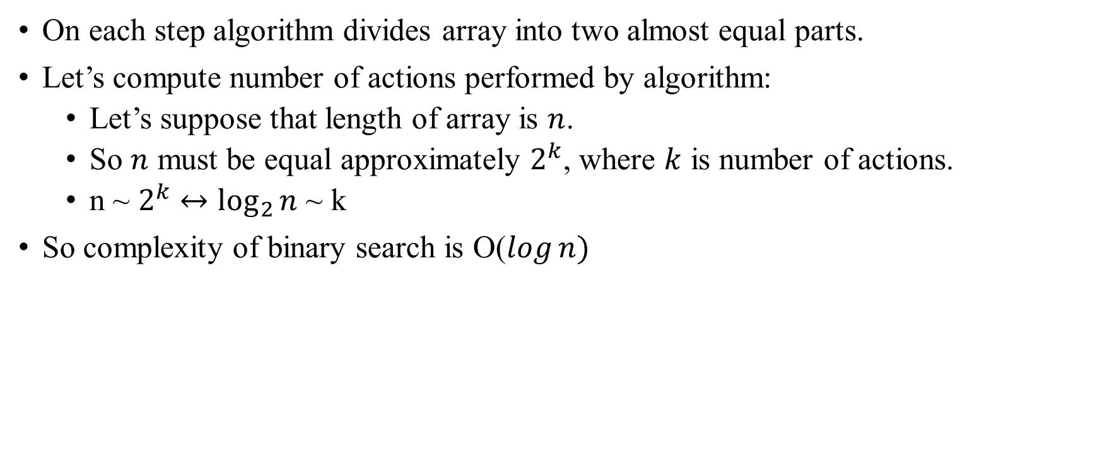
Binary Search Complexity
On each step algorithm divides array into two almost equal parts.
Let’s compute number of actions performed by algorithm:
Let’s suppose that length of array is $n$.
So $n$ must be equal approximately $2^{k}$, where $k$ is number of actions.
n ~ $2^{k}$ $↔\log_{2}{n}$ ~ k
So complexity of binary search is O($\log{n)}$

